Slide 1



Foundations of Data Science
By Dr. Shagun Sharma

Slide 2
Table of Contents
What is Data Science? Big Data and Data Science
Datafication – Current landscape of perspectives – Skill sets needed;
Matrices – Matrices to represent relations between data, and necessary linear algebraic operations on matrices
Approximately representing matrices by decompositions (SVD and PCA); Statistics: Descriptive Statistics: distributions
and probability – Statistical Inference: Populations and samples – Statistical
modeling – probability distributions – fitting a model – Hypothesis Testing –
Intro to R/ Python.

Slide 3
What is Data Science?
Data Science is a multidisciplinary field that uses scientific methods, algorithms, and tools to extract knowledge and insights from large, complex datasets (structured & unstructured) to solve problems, find patterns, and make predictions, blending statistics, AI, and computer science for data-driven decisions in areas like business, healthcare, and tech.
It involves collecting, cleaning, analyzing, visualizing, and interpreting data to understand "what happened," "why," and "what might happen next," ultimately guiding better actions.

Slide 4
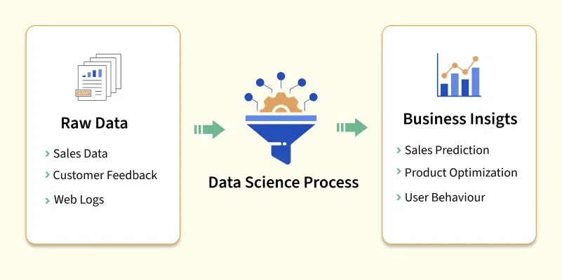
What is Data Science?

Slide 5
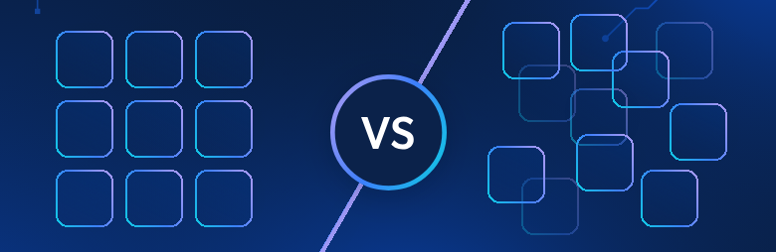
Find the Structured and Unstructured Data

Slide 6
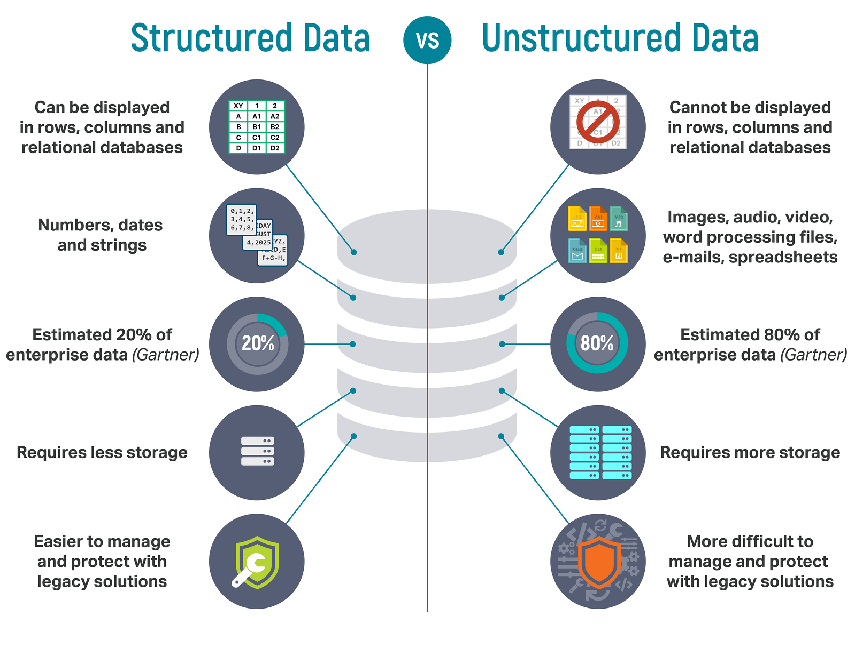
Find the Structured and Unstructured Data

Slide 7
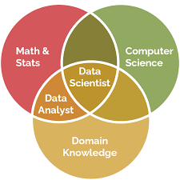
What does data science find?
What do customers want?
How can we improve our services?
What will the upcoming trend in sales?
How much stock they need for upcoming festival.
Data science empowers the industries to make smarter, faster, and more informed decisions. In order to find patterns and achieve such insights, expertise in relevant domain is required. With expertise in Healthcare, a data scientists can predict patient risks and suggest personalized treatments.

Slide 8
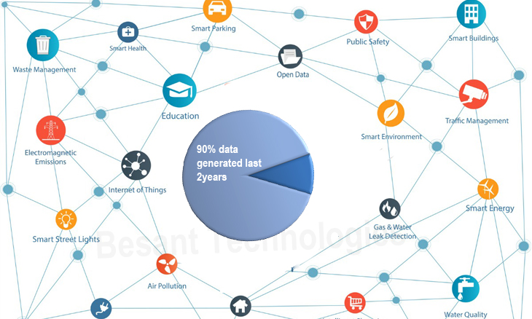
Real-world examples of data science
Netflix/Spotify: Suggesting what you might like next based on your viewing/listening history.
E-commerce: Showing you relevant products and personalizing offers.
Healthcare: Predicting disease outbreaks or understanding treatment effectiveness.
Finance: Detecting fraud or forecasting stock market trends.

Slide 9
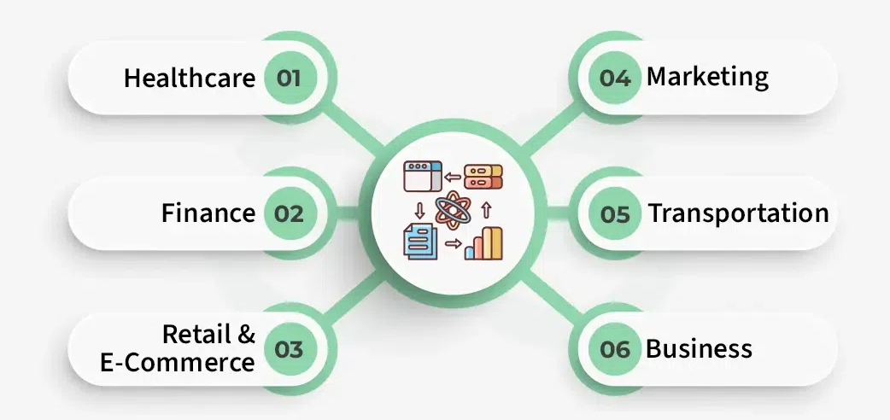
Where data science is being used?
Data Science is being used in almost all major industry. Here are some examples:
Predicting customer preferences for personalized recommendations.
Detecting fraud in financial transactions.
Forecasting sales and market trends.
Enhancing healthcare with predictive diagnostics and personalized treatments.
Identifying risks and opportunities in investments.
Optimizing supply chains and inventory management.

Slide 10
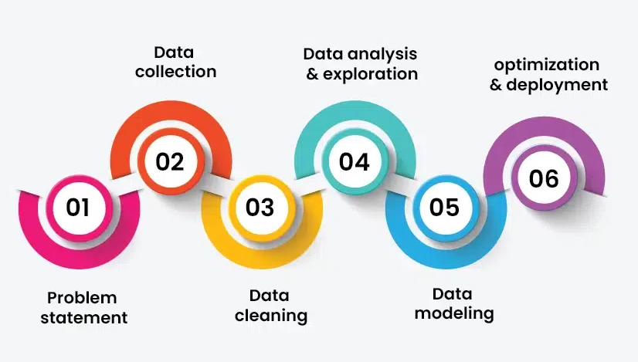
Data Science Life Cycle
Data science is not a one-step process such that you will get to learn it in a short time and call ourselves a Data Scientist. It's passes from many stages and every element is important. One should always follow the proper steps to reach the ladder. Every step has its value and it counts in your model.

Slide 11
Data Science Life Cycle
1. Problem Statement: Identifying and defining the problem.
2. Data Collection: After defining the problem statement, the next step is to go in search of data that you might require for your model. You must do good research, find all that you need. Data can be in any form i.e unstructured or structured. It might be in various forms like videos, spreadsheets, coded forms, etc. You must collect all these kinds of sources.
3. Data Cleaning: Data cleaning is all about the removal of missing, redundant, unnecessary and duplicate data from your collection.
4. Data Analysis and Exploration: It analyzes the structure of data, finding hidden patterns in them, studying behaviors, visualizing the effects of one variable over others and then concluding.

Slide 12
Data Science Life Cycle
5. Data Modelling: In this step, we choose an algorithm that best fits to the data. There different kinds of algorithms from regression, classification, and Clustering, etc.
6. Optimization and Deployment: In this step, you test your data and find how well it is performing by checking its accuracy. The efficiency of the model is checked and thus try to optimize it for better accurate prediction. Deployment deals with the launch of the model and let the people outside there to benefit from that. You can also obtain feedback from organizations and people to know their need and then to work more on your model.

Slide 13
Data Science Tools and Libraries
Jupyter Notebook: Interactive environment for coding and documentation.
Google Colab: Cloud-based Jupyter Notebook for collaborative coding.
TensorFlow: Deep learning framework for building neural networks.
PyTorch: Popular library for machine learning and deep learning.
Scikit-learn: Tools for predictive data analysis and machine learning.
Docker: Containerization for reproducible environments.
Kubernetes: Managing and scaling containerized applications.
Apache Kafka: Real-time data streaming and processing.
Tableau: A powerful tool for creating interactive and shareable data visualizations.
Power BI: A business intelligence tool for visualizing data and generating insights.
Keras: A user-friendly library for designing and training deep learning models.

Slide 14
What is Big Data?
Big Data is a massive collection of complex information (text, numbers, images, videos) that's too large and fast for normal tools like spreadsheets to handle, requiring special systems to find valuable patterns for better decisions, like predicting customer needs or improving services.
It's defined by the 5 Vs that are:
Volume
Velocity
Variety
Veracity
Value

Slide 15
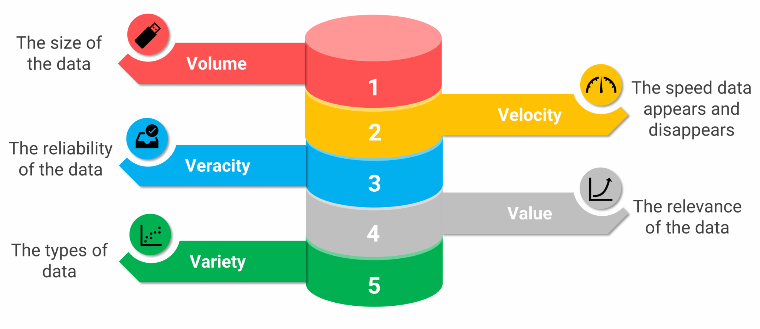
What is Big Data?

Slide 16
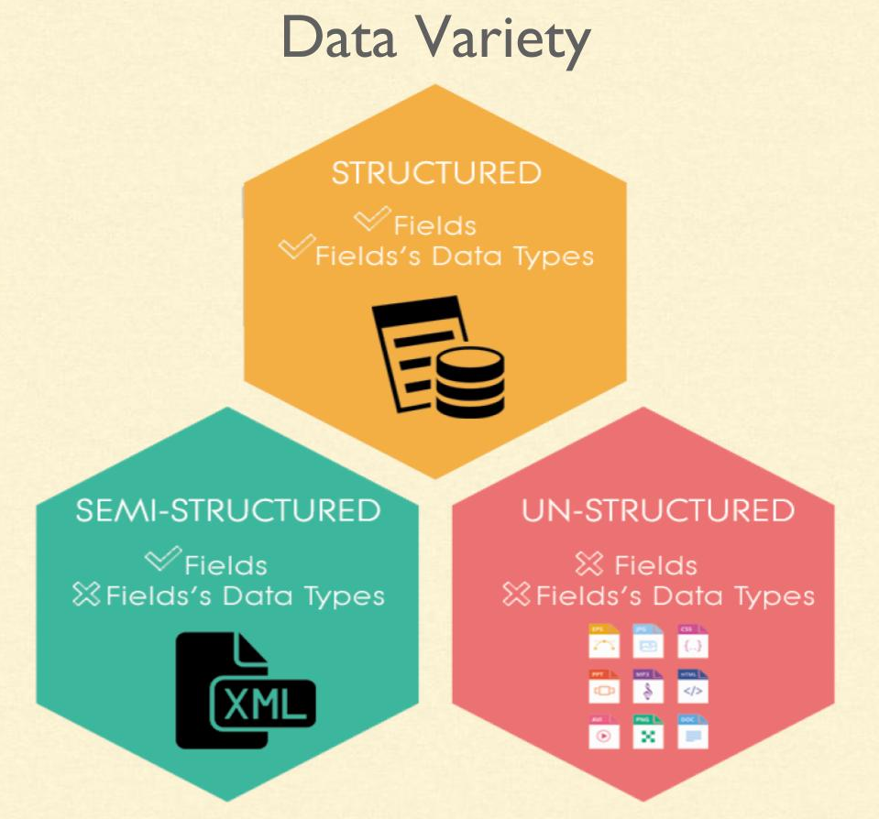
5 V’s in Big Data
Volume: The sheer massive scale of data being generated from sources like social media, sensors, and transactions, often too large for traditional systems.
Velocity: The speed at which data is created, collected, and needs to be processed, such as real-time stock trades or streaming data.
Variety: The diversity of data formats, including structured (databases), unstructured (text, images, video), and semi-structured data.

Slide 17
5 V’s in Big Data
Volume: The sheer massive scale of data being generated from sources like social media, sensors, and transactions, often too large for traditional systems.
Velocity: The speed at which data is created, collected, and needs to be processed, such as real-time stock trades or streaming data.
Variety: The diversity of data formats, including structured (databases), unstructured (text, images, video), and semi-structured data.
Veracity: The accuracy, reliability, and trustworthiness of the data, dealing with inconsistencies and biases to ensure data quality.
Value: The ultimate goal which is extracting meaningful, actionable insights and economic benefit from the data to drive decisions and innovation.

Slide 18
Datafication

Slide 19
What is Datafication?
Datafication is the process of converting aspects of life, business, and society—like behaviors, interactions, and phenomena—into quantifiable data that can be collected, stored, and analyzed, providing raw material for data science, machine learning, and AI to reveal patterns, make predictions, and generate new value, moving beyond simple digitization to capture the "what" and "how" of activities.
It turns previously unmeasurable things (like customer sentiment or traffic flow) into digital records, enabling deeper insights and improved decision-making.

Slide 20
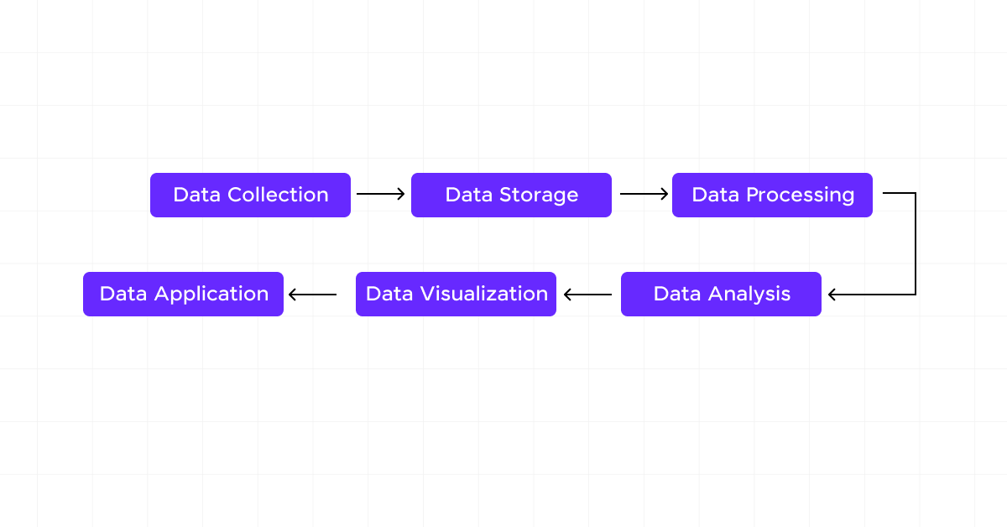
How Datafication is Performed?

Slide 21
How Datafication is Performed?
1. Data Collection: It all starts with data collection and retrieval. This could be from anything you do—clicking on a website, using an app, or even just walking around with your smartphone. Devices and sensors collect this data, often without you even noticing.
2. Data Storage: Once collected, this data needs a place to go. Think of it like storing your favorite movies or music. The data is saved in databases or cloud storage, where it can be accessed and used later.
3. Data Processing: Here’s where things get interesting. The raw data collected isn’t very useful on its own. It’s like having all the ingredients for a cake but not baking it yet. Data processing involves data cleaning, organizing, and transforming this data into a more usable format. For example, if you’ve ever used a spreadsheet to track your expenses, you’ve engaged in a basic form of data processing.

Slide 22
How Datafication is Performed?
4. Data Analysis: This is the magic moment when data becomes valuable information. Using various tools and techniques, analysts can look at patterns and trends in the data. For example, they might discover that people tend to buy more ice cream on hot days—a useful insight for a business.
5. Data Visualization: To make the data easy to understand, it’s often presented visually, like in charts or graphs. If you’ve ever seen a bar chart showing monthly sales or a line graph tracking your steps over time, you’ve encountered data visualization. This step helps people quickly grasp the insights hidden in the data.
6. Data Application: Finally, the insights gained from data analysis are put to use. This could mean anything from tweaking a marketing strategy to designing a new product. For example, if data shows that customers prefer shopping online at certain times of the day, a business might run targeted ads during those hours.

Slide 23
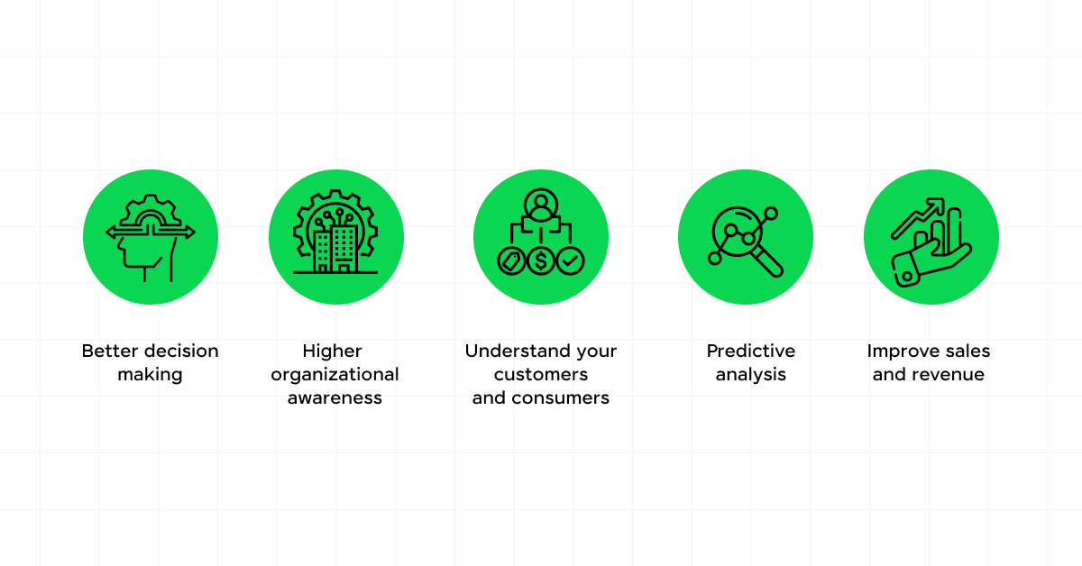
Why Datafication is important?

Slide 24
How Datafication is Performed?
1. Informed Decision-Making
Imagine you’re planning a vacation. You want to find the best hotel at the best price, right? Datafication plays a huge role here. By analyzing data from various travel websites, you can compare prices, read reviews, and even see trends in booking rates.
2. Personalization
Have you ever noticed how streaming or retail services like Netflix or Amazon seem to know exactly what you want to watch or order next? That’s datafication at work.
3. Efficiency and Innovation
Datafication isn’t just about making things convenient; it’s also about driving efficiency and innovation. Think about the last time you used a navigation app like Google Maps. The app collects real-time traffic data from millions of users to provide the quickest route to your destination.

Slide 25
How Datafication is Performed?
4. Enhanced User Experience
Companies use datafication to improve your overall experience with their products or services. For instance, if you’ve ever received an email from a company asking for feedback on a recent purchase, that’s datafication at work.
5. Predictive Capabilities
Another exciting aspect of datafication is its predictive capabilities. By analyzing past behaviors and trends, businesses can predict future outcomes.
For example, a retailer might use data to forecast which products will be popular during the holiday season, allowing them to stock up accordingly.

Slide 26

Real World Examples of Datafication

Slide 27
Real World Examples of Datafication
Social Media
These platforms collect data on your interactions—likes, shares, comments, and even the time you spend looking at certain posts. By analyzing this data, social media companies can tailor your feed to show more of what you like and less of what you don’t.
This isn’t just about keeping you engaged, it’s also about delivering targeted ads that are relevant to you. If you’ve ever seen an ad pop up for something you were just thinking about, it’s because datafication has been at work, analyzing your behavior and preferences.

Slide 28
Real World Examples of Datafication
2. Smart Homes
Imagine coming home after a long day, and your house adjusts the lighting, temperature, and even plays your favorite music as you walk in.
Devices like smart thermostats, lights, and security systems collect data on your daily routines and preferences. They learn when you typically get home, your preferred temperature settings, and even the times when you’re usually away.
This data helps automate tasks, making your life more convenient and energy-efficient. It’s like having a personal butler who knows your preferences and schedules.

Slide 29
Real World Examples of Datafication
3. Fitness Trackers
If you’ve ever used a fitness tracker like a Fitbit or an Apple Watch, you’re already familiar with datafication in action. These devices collect data on your steps, heart rate, sleep patterns, and more.
This data isn’t just for show, it helps you understand your health and fitness levels. For example, by tracking your steps and calories burned, you can set and achieve fitness goals.
If your heart rate spikes unexpectedly, your device can alert you to potential health issues. Moreover, many fitness apps allow you to share your data with healthcare providers, giving them valuable insights into your health that can lead to better, more personalized care.

Slide 30
Real World Examples of Datafication
4. Retail and Online Shopping
Have you ever noticed how online stores like Amazon seem to know exactly what you want to buy? This isn’t just clever marketing, it’s datafication at work.
Retailers track your browsing history, past purchases, and even the items you’ve looked at but didn’t buy. By analyzing this data, they can recommend products that are tailored to your tastes and needs.
This personalized shopping experience not only makes it easier for you to find what you’re looking for but also introduces you to new products you might not have considered otherwise.

Slide 31
Real World Examples of Datafication
5. Navigation and Ride-Sharing Apps
Ever used Google Maps or a ride-sharing app like Uber or Ola? These services are excellent examples of datafication in action. They collect data from millions of users to provide real-time traffic updates, optimal routes, and estimated arrival times.
For ride-sharing apps, this data helps match you with drivers and calculate fare estimates based on distance, traffic, and time of day. This not only makes your commute more efficient but also enhances safety by providing you with accurate and up-to-date information.
These examples show how datafication is seamlessly integrated into our daily lives, often in ways we don’t even notice. As you continue to interact with these technologies, being aware of how your data is used can help you make more informed decisions and fully enjoy the benefits of a data-driven world.

Slide 32
Current landscape of perspectives – Skill sets needed

Slide 33
Current landscape of perspectives
Business/Economic
Focuses on driving efficiency, customer understanding, and new revenue streams through data-driven decisions.
Technical/Analytical
Emphasizes using statistical methods, machine learning (ML), and AI to find patterns and predict outcomes.
Ethical/Societal
Addresses privacy, bias, and the responsible use of data, ensuring fairness and minimizing negative impacts.
Interdisciplinary
Recognizes the need for collaboration between data scientists, domain experts (healthcare, finance), and humanities to tackle complex problems.

Slide 34
Current landscape of perspectives
AI and Machine Learning
Data science is increasingly intertwined with artificial intelligence (AI) and machine learning, enabling more advanced predictive analytics and automation of data-driven processes.
Big Data
The proliferation of big data continues to shape the data science landscape, with organizations leveraging large volumes of data from diverse sources to gain insights and make informed decisions.
Ethics and Privacy
There is a growing emphasis on ethical considerations and privacy concerns in data science, with a focus on responsible data usage, transparency, and compliance with regulations such as GDPR.

Slide 35
Current landscape of perspectives
Interdisciplinary Collaboration
Data science is increasingly viewed as a multidisciplinary field, requiring collaboration between data scientists, domain experts, and stakeholders to ensure the meaningful interpretation and application of data-driven insights.
Data Visualization and Interpretability
The importance of effective data visualization and interpretability techniques is on the rise, as stakeholders seek to comprehend and communicate complex data findings in a more accessible manner.

Slide 36
Skill sets needed
Programming
Python (for data manipulation/ML) & SQL (for database queries).
Data Engineering
ETL (Extract, Transform, Load) tools (Apache Airflow, Talend), cloud platforms (AWS Glue), building data pipelines.
Data Analysis & ML
Statistics, probability, regression models, machine learning algorithms (PCA, SVD), and AI.
Data Visualization
Tools to present insights clearly (dashboards, graphs).

Slide 37
Skill sets needed
Domain Knowledge
Understanding the specific industry (finance, healthcare) to ask the right questions and interpret results.
Soft Skills
Critical thinking, problem-solving, and ethical awareness to handle data responsibly.

Slide 38
Matrices
– Matrices to represent relations between data

Slide 39
What is Matrices in Data Science?
Matrices are a foundational concept in data science that underpins a wide range of mathematical and computational operations used for analyzing and manipulating data.
It provides a structured and organized way to represent information, making it easier to process and extract meaningful insights. In this comprehensive explanation, we’ll delve deeper into matrices in the context of data science, exploring their properties, operations, and applications.

Slide 40
What is Matrices in Data Science?
Matrix Basics
A matrix is a two-dimensional array of numbers arranged in rows and columns. Each element in a matrix is identified by its row and column index.
A matrix with “m” rows and “n” columns is often referred to as an “m x n” matrix. Matrices are used to represent datasets, where each row corresponds to an observation or sample, and each column represents a feature or attribute of that sample.
This structured representation makes it convenient to apply mathematical operations and transformations to the data.

Slide 41
What is Matrices in Data Science?
Data Representation
In data science, matrices serve as a powerful tool for representing datasets. Consider a dataset containing information about various individuals, such as age, income, and education level.
By organizing this data into a matrix, where each row corresponds to an individual and each column represents a different attribute, we create a structured representation that facilitates analysis.
This tabular arrangement simplifies operations like finding averages, and correlations, and performing statistical analyses.

Slide 42
What is Matrices in Data Science?
Linear Transformation
Matrices are key players in the realm of linear transformations, which are fundamental to data manipulation and feature engineering.
These transformations involve scaling, rotating, reflecting, and translating data points. In data science, linear transformations are utilized for data preprocessing and dimensionality reduction.
For example, Principal Component Analysis (PCA) leverages matrices to identify orthogonal axes that maximize the variance in data, leading to effective dimensionality reduction.

Slide 43
What is Matrices in Data Science?
Matrix Operation
Matrices support a multitude of operations that are essential in data science:
Addition and subtraction: Matrices with the same dimensions can be added or subtracted element-wise, facilitating tasks such as aggregating data from multiple sources.
Scalar Multiplication: Each element of a matrix can be multiplied by a scalar value, which can be useful for scaling data.
Matrix Multiplication: Matrix multiplication is a central operation that combines the rows and columns of matrices to produce a new matrix. The element at position (i, j) in the resulting matrix is the dot product of the “i”-th row of the first matrix and the “j”-th column of the second matrix. Matrix multiplication is crucial for composing linear transformations and forms the foundation of various machine learning algorithms.

Slide 44
What is Matrices in Data Science?
Matrix Operation
Matrices support a multitude of operations that are essential in data science:
Transpose: The transpose of a matrix is obtained by interchanging its rows and columns. This operation is valuable for solving systems of linear equations and for extracting features in certain algorithms.

Slide 45
What is Matrices in Data Science?
Image and Signal Processing
In image and signal processing, matrices are used to represent images and signals as pixel values in a grid. Operations like convolution are applied to matrices to perform tasks such as edge detection and feature extraction in images. Convolutional Neural Networks (CNNs) use matrix convolutions to learn and recognize patterns in images.
Graphs and Networks
Matrices are used to represent relationships in graphs and networks. The adjacency matrix, for instance, represents connections between nodes in a graph. Matrices like the Laplacian matrix help analyze graph properties and identify clusters or communities within networks.

Slide 46
What is Matrices in Data Science?
Matrices are a cornerstone of data science, facilitating the representation, transformation, and analysis of data.
Understanding matrices and their operations is vital for proficiently applying machine learning algorithms, conducting statistical analyses, and extracting insights from complex datasets.
By harnessing the power of matrices, data scientists can unlock the potential hidden within data and drive informed decision-making across various domains.

Slide 47
Necessary linear algebraic operations on matrices

Slide 48
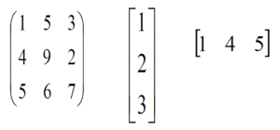
What is Matrix?
A Matrix is a rectangular arrangement of numbers in rows and columns.
In a matrix, as we know rows are the ones that run horizontally and columns are the ones that run vertically. The following image shows the examples of matrices.

Slide 49
What are the Algebraic Operations?
Basic algebraic operations are any one of the traditional operations of arithmetic, which are addition, subtraction, multiplication, division, raising to an integer power, and taking roots. These operations may be performed on numbers, in which case they are often called arithmetic operations.

Slide 50
Singular Value Decomposition (SVD)

Slide 51
SVD
Singular Value Decomposition (SVD) is a powerful mathematical technique in data science used to break down a dataset (represented as a matrix or a table of numbers) into three simpler, meaningful components. This process helps uncover hidden patterns, simplify data, and reduce noise.
SVD (Singular Value Decomposition) in data science is a powerful matrix factorization technique that breaks a data matrix (A) into three simpler matrices (U), (∑), (V^{T}), revealing underlying patterns for tasks like dimensionality reduction, noise reduction, data compression, and recommendation systems. It identifies key features (singular vectors in (U) and (V) and their importance (singular values in (∑) by extracting dominant correlations, allowing for simplification and better interpretation of high-dimensional data.

Slide 52
SVD
Singular Value Decomposition (SVD) is a factorization method in linear algebra that decomposes a matrix into three other matrices, providing a way to represent data in terms of its singular values.
SVD helps you split that table into three parts:
U: This part tells you about the people (like their general preferences).
Σ: This part shows how important each factor is (how much each rating matters).
Vᵀ: This part tells you about the products (how similar they are to each other)

Slide 53
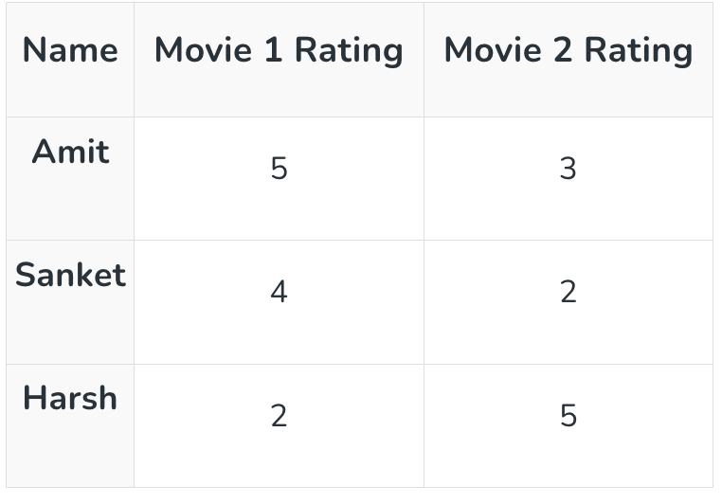
Example of SVD
SVD breaks this table into three smaller parts: one that shows people’s preferences, one that shows the importance of each movie, and one that shows how similar the movies are to each other.
Mathematically, the SVD of a matrix A (size m × n) is represented as: A = U Σ V^{T}

Slide 54
Example of SVD
SVD breaks this table into three smaller parts: one that shows people’s preferences, one that shows the importance of each movie, and one that shows how similar the movies are to each other.
Mathematically, the SVD of a matrix A (size m × n) is represented as: A = U Σ V^{T}

Slide 55
Why SVD?
Dimensionality Reduction: SVD can reduce the number of features (columns) in a large dataset while retaining the most important information. This makes data easier to work with and speeds up machine learning algorithms (similar to how Principal Component Analysis, or PCA, works).
Image Compression: SVD is used to compress large images efficiently. By keeping only a few of the largest singular values and their corresponding vectors, you can reconstruct an image that looks almost identical to the human eye but uses significantly less storage space.

Slide 56
Why SVD?
Recommendation Systems: Platforms like Netflix and Amazon use SVD to analyze user-item interaction data. It helps uncover hidden preferences (latent factors) and predict what a user might like to watch or buy next, leading to personalized recommendations.
Natural Language Processing (NLP): SVD is used in a technique called Latent Semantic Analysis (LSA) to understand the relationships between words and documents, improving search engine relevance and topic modeling.

Slide 57
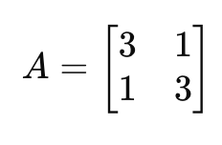
Example of SVD?
Take a Matrix
Goal of SVD:
A=UΣV^{T}
Where
U: left singular vectors (orthogonal)
Σ: singular values (diagonal, ≥ 0)
V: right singular vectors (orthogonal)

Slide 58
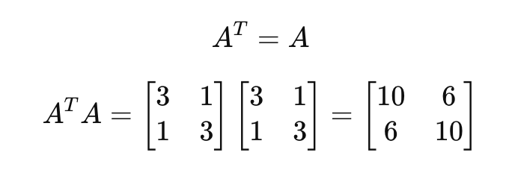
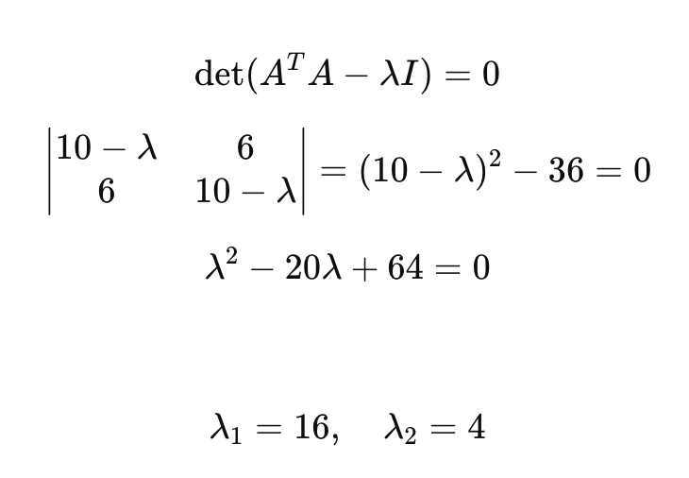
Example of SVD?
STEP 1: Compute A^{T}A
STEP 2: Find Eigenvalues of A^{T}A

Slide 59
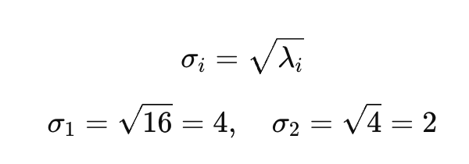
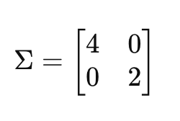
Example of SVD?
STEP 3: Compute Singular Values
STEP 4: Form Σ

Slide 60
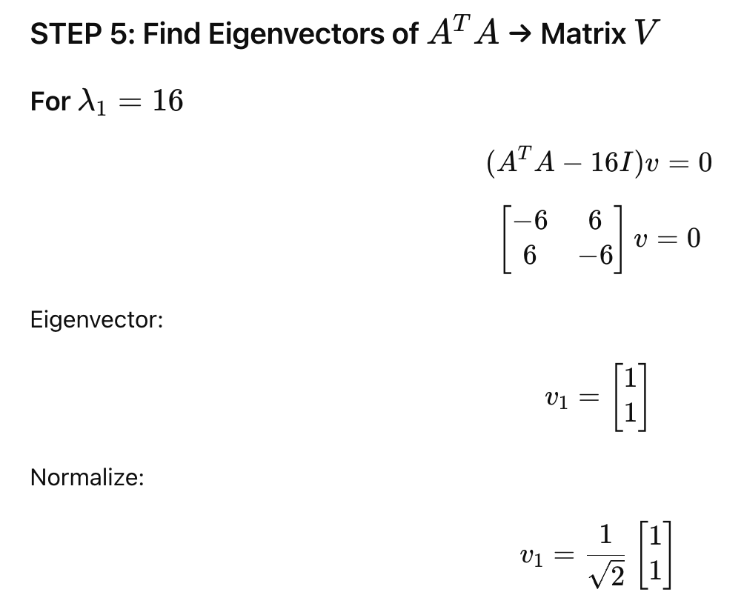
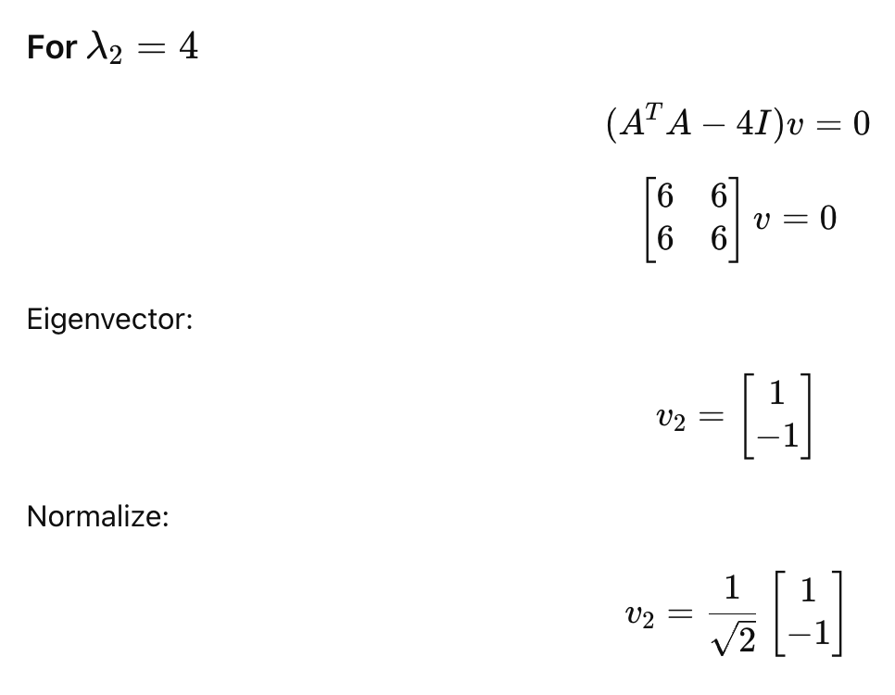
Example of SVD?

Slide 61
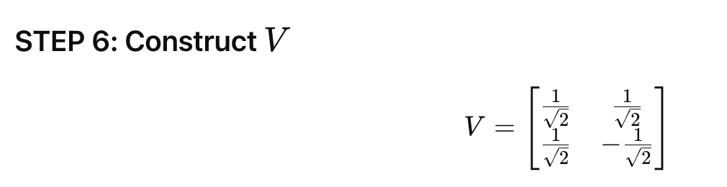
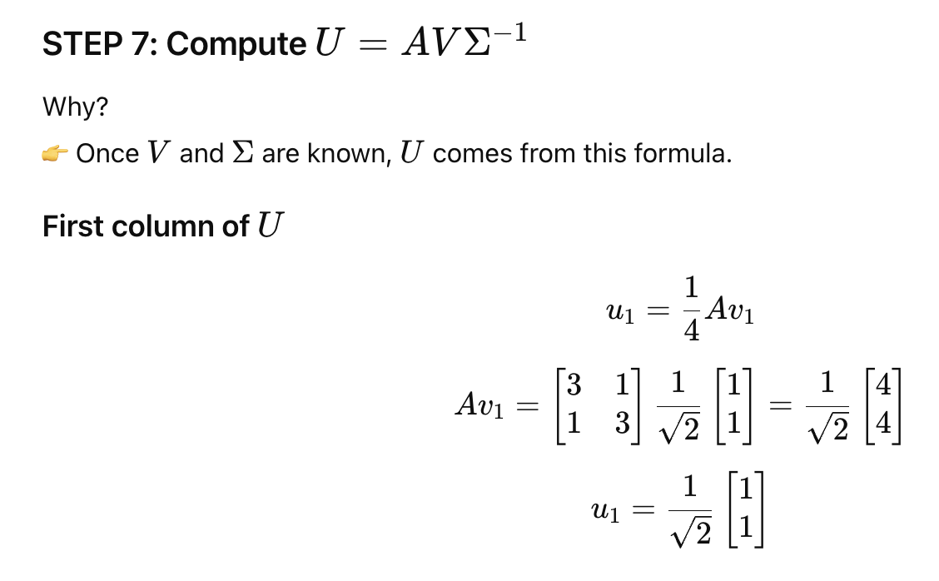
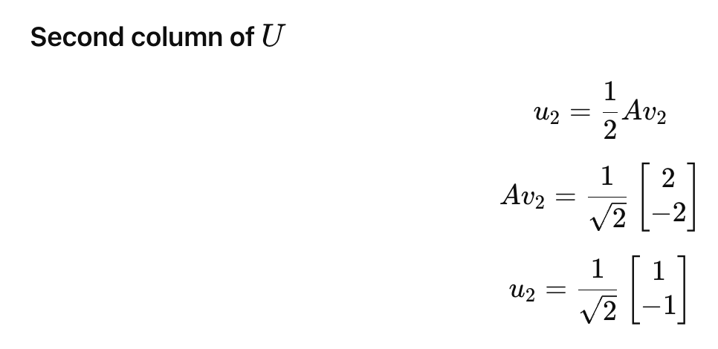
Example of SVD?

Slide 62
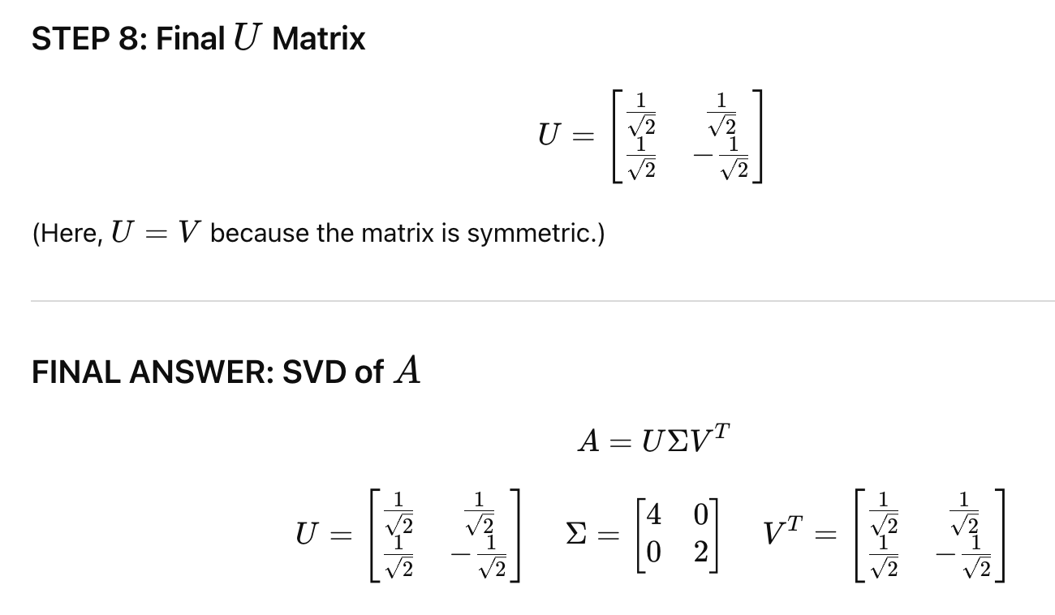
Example of SVD?

Slide 63
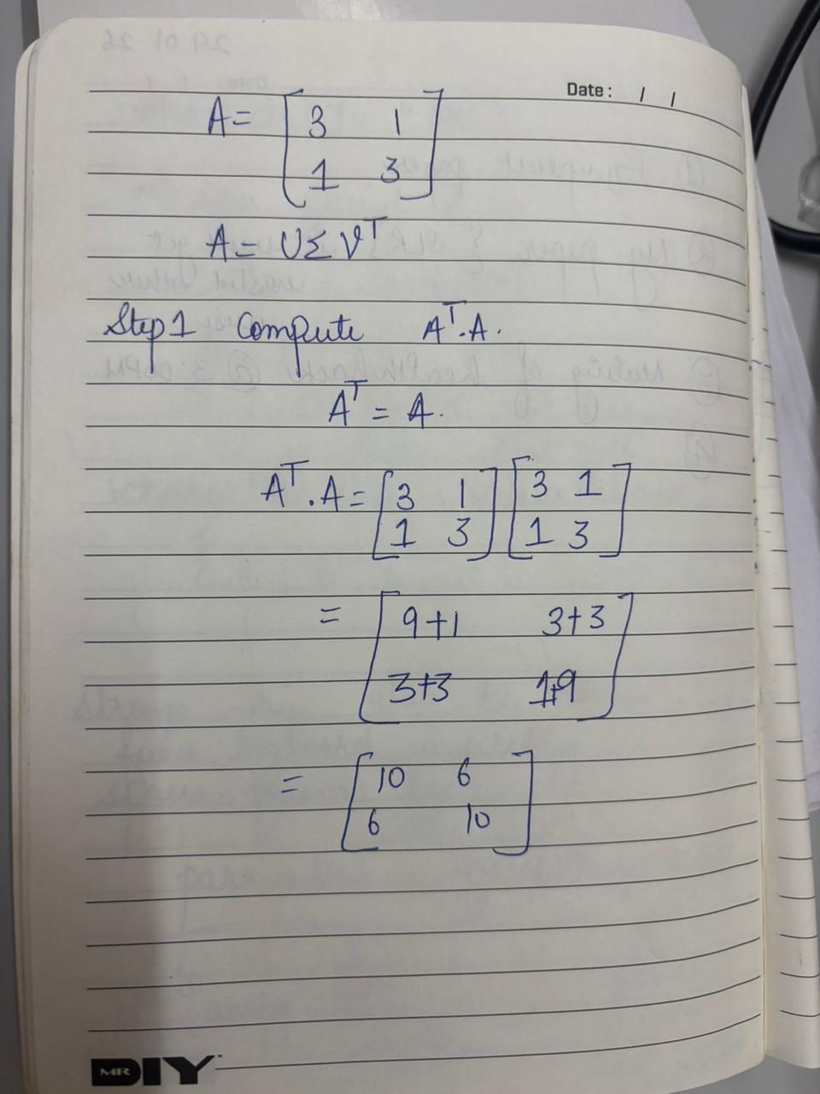
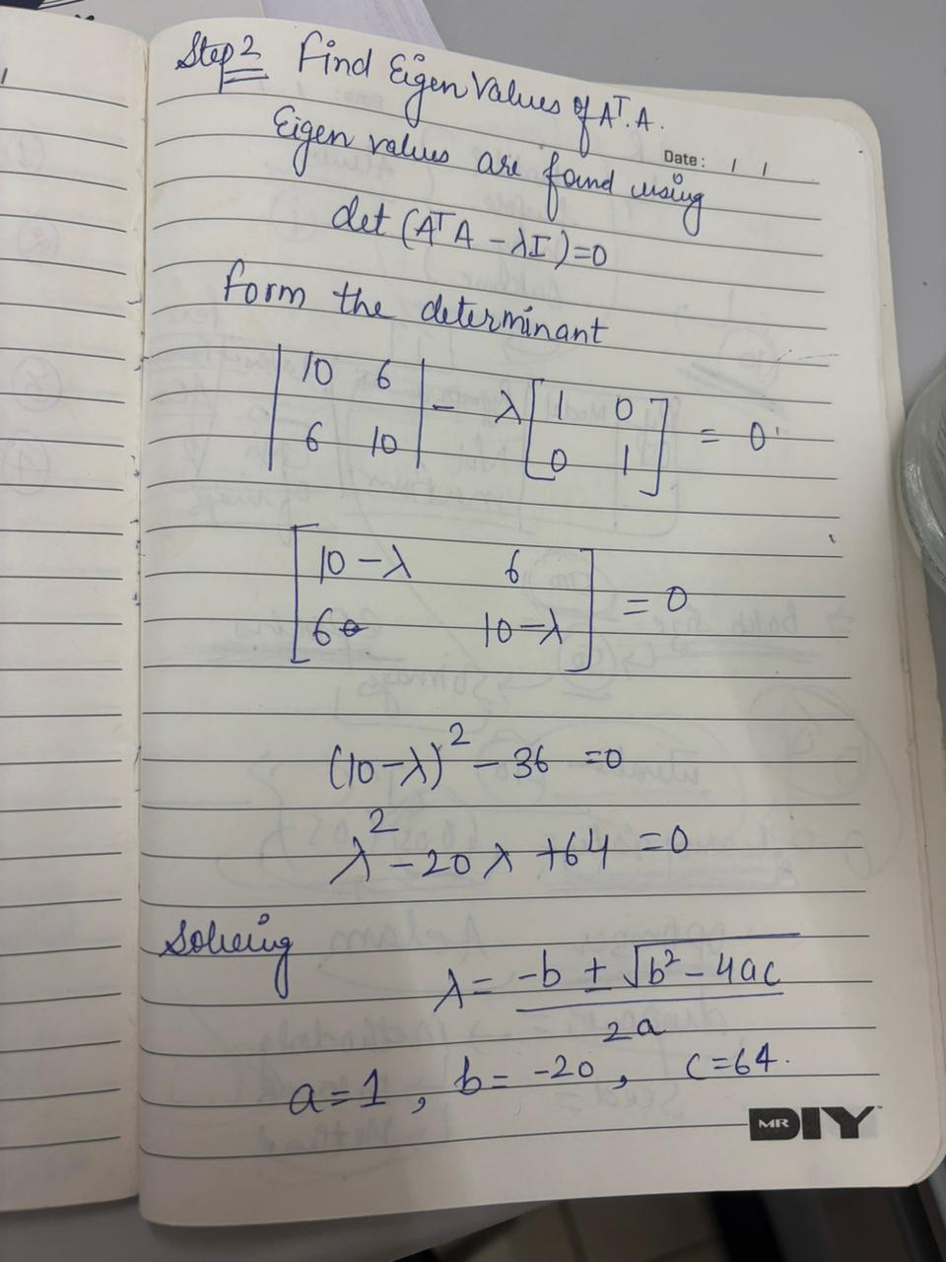
Step by step Breakdown

Slide 64
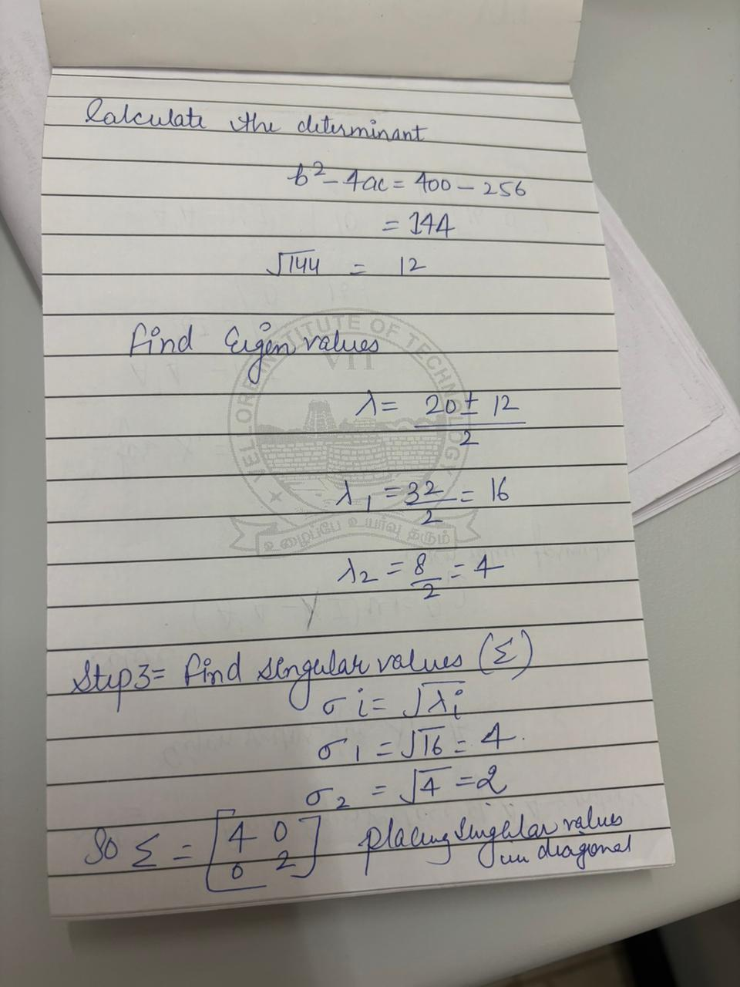

Step by step Breakdown

Slide 65


Step by step Breakdown

Slide 66


Step by step Breakdown

Slide 67

Step by step Breakdown

Slide 68
PCA (Principle Component Analysis)
In simple terms, Principal Component Analysis (PCA) is a smart way to simplify complex data by reducing its many features (dimensions) into a smaller, more manageable set of "principal components" that still hold almost all the important information, like summarizing a detailed book into a few key chapters.
It finds the most important directions (components) in the data where the spread (variance) is greatest, making data faster for models to learn from, easier to visualize, and helping to remove noise or redundancy.
PCA (Principal Component Analysis) is a dimensionality reduction technique and helps us to reduce the number of features in a dataset while keeping the most important information. It changes complex datasets by transforming correlated features into a smaller set of uncorrelated components.

Slide 69
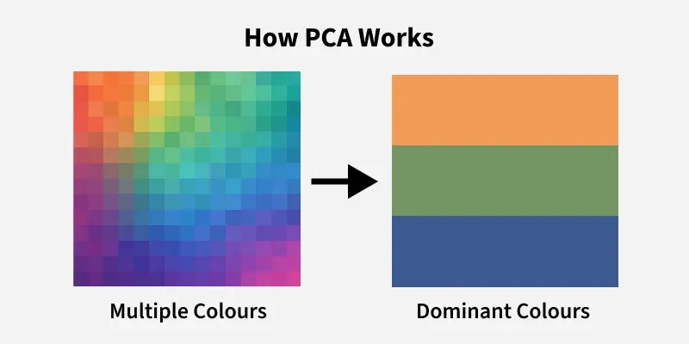
How PCA Works?
Imagine you have a detailed photo of a cat with tons of pixels (features).
PCA finds the best angles to look at the cat so you can describe it with fewer words (components) while still capturing its essential shape, eyes, and ears, discarding irrelevant background details.

Slide 70
Key goals of PCA
Dimensionality Reduction: Takes many features (like height, weight, age, income) and combines them into fewer, new features (PCs).
Information Preservation: Captures the most significant patterns and variance in the data, ensuring important info isn't lost.
Noise Reduction: Filters out random noise, leading to cleaner data.
Faster Models: Simpler data means machine learning algorithms train quicker and perform better

Slide 71
When it's used
Data Visualization: Makes high-dimensional data viewable on a 2D or 3D graph.
Preprocessing: A common first step before applying other ML algorithms to speed them up.
Feature Extraction: Creating new, uncorrelated features from existing ones.

Slide 72
SVD Vs PCA
Singular Value Decomposition (SVD)
What it does: A matrix factorization technique that breaks down any matrix (not just square or symmetric ones) into three simpler matrices (U, Σ, Vᵀ).
Goal: Decompose data into fundamental components (rotations, scaling, another rotation).
How: Gives you singular vectors (directions) and singular values (importance/magnitude).
Principal Component Analysis (PCA)
What it does: Finds new, uncorrelated variables (Principal Components) that capture the maximum variance in the data, helping to reduce dimensions and visualize complex datasets.
Goal: Feature extraction and dimensionality reduction by identifying the most significant patterns (directions of highest variance).
How: Finds eigenvectors and eigenvalues of the covariance matrix.

Slide 73
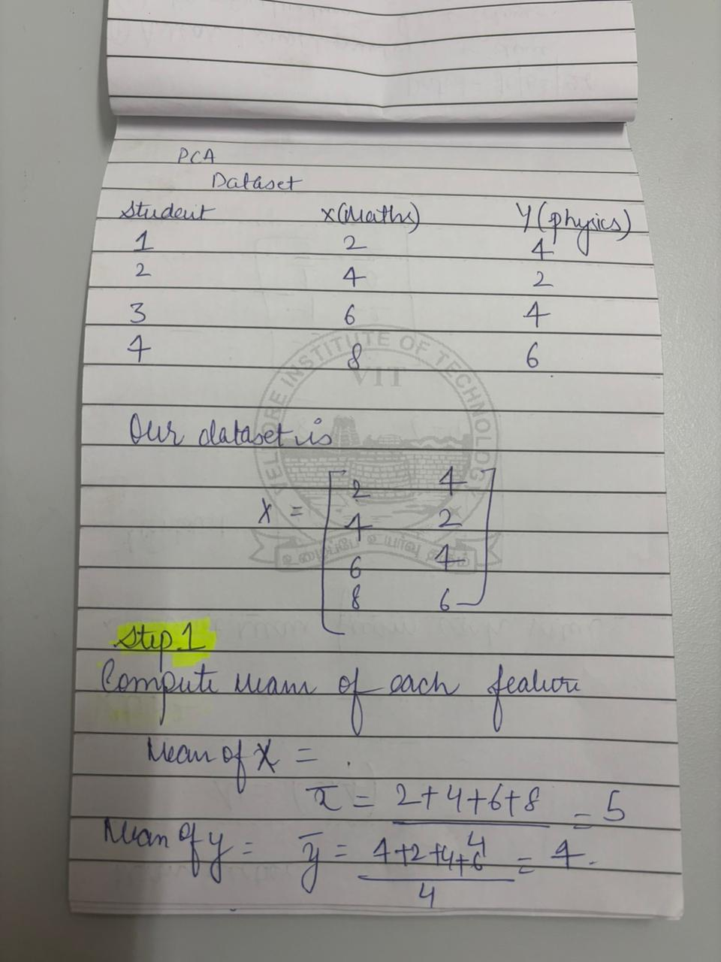
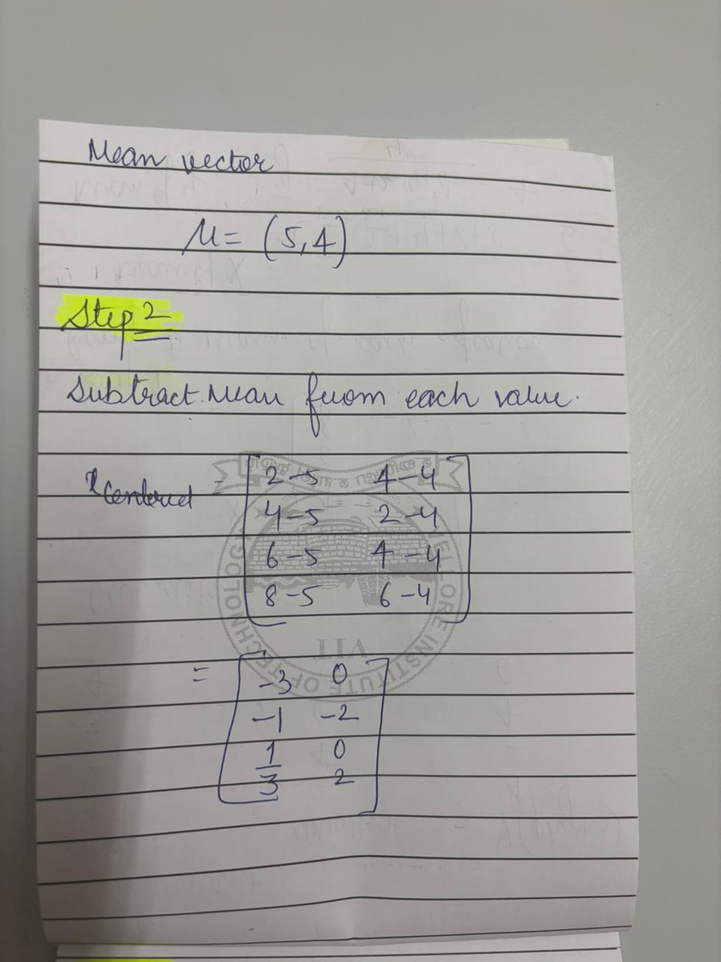
PCA Solved Example

Slide 74


PCA Solved Example

Slide 75
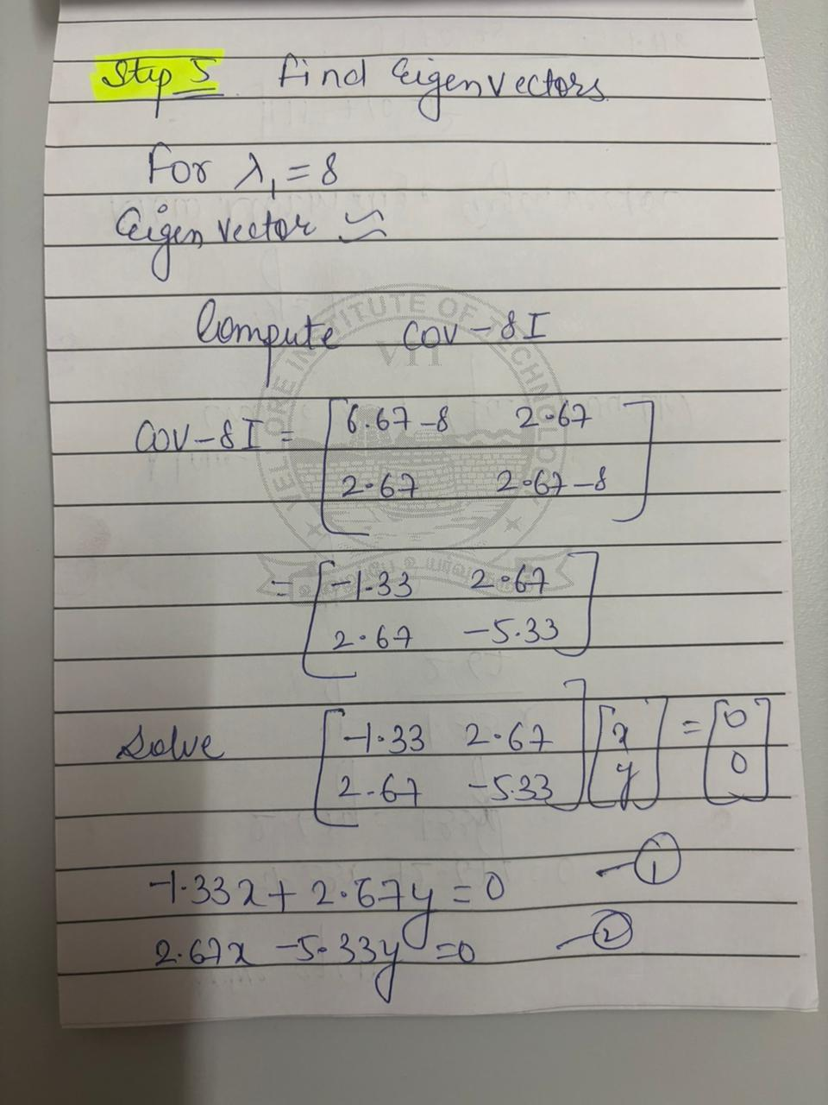
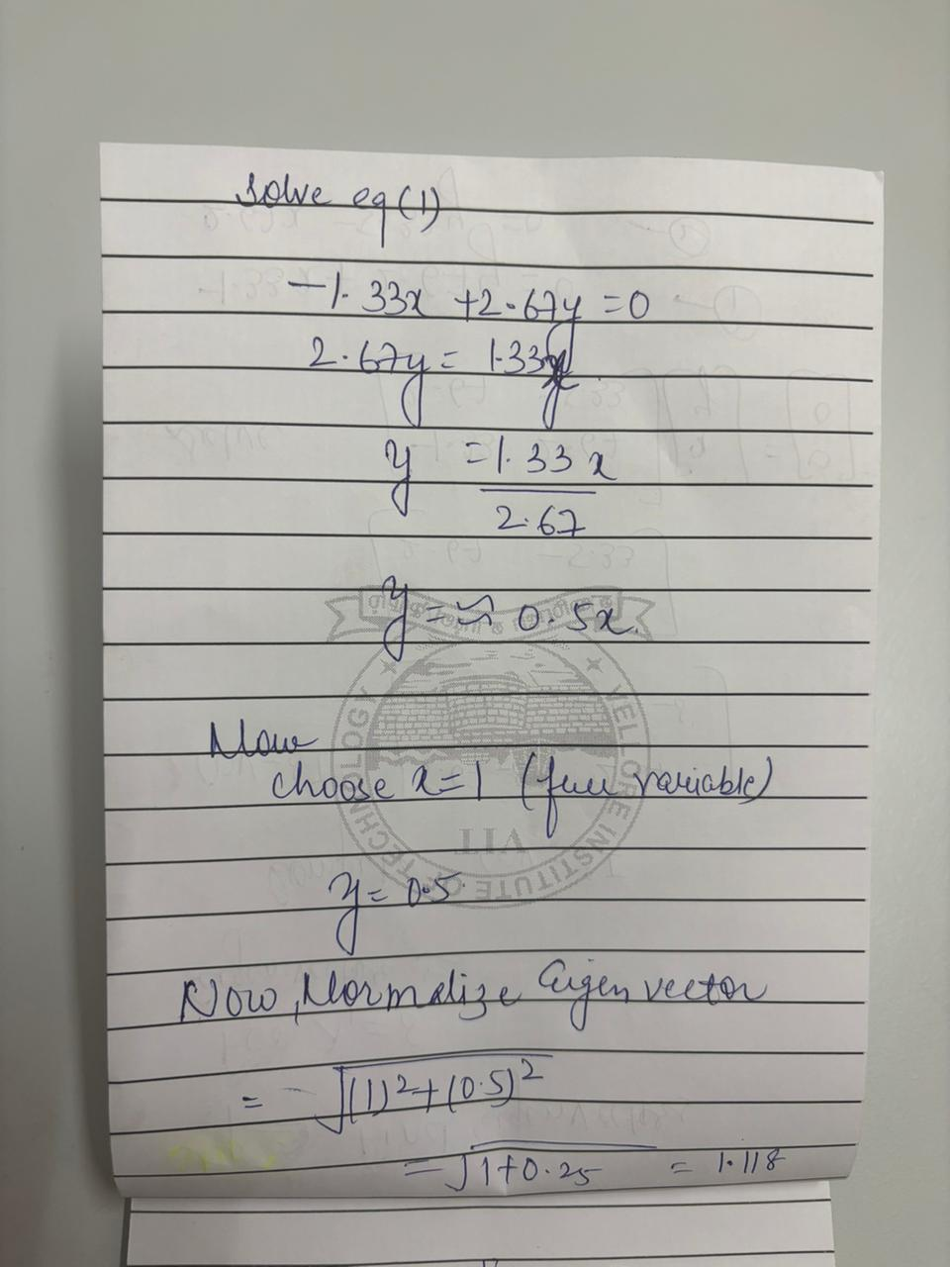
PCA Solved Example

Slide 76
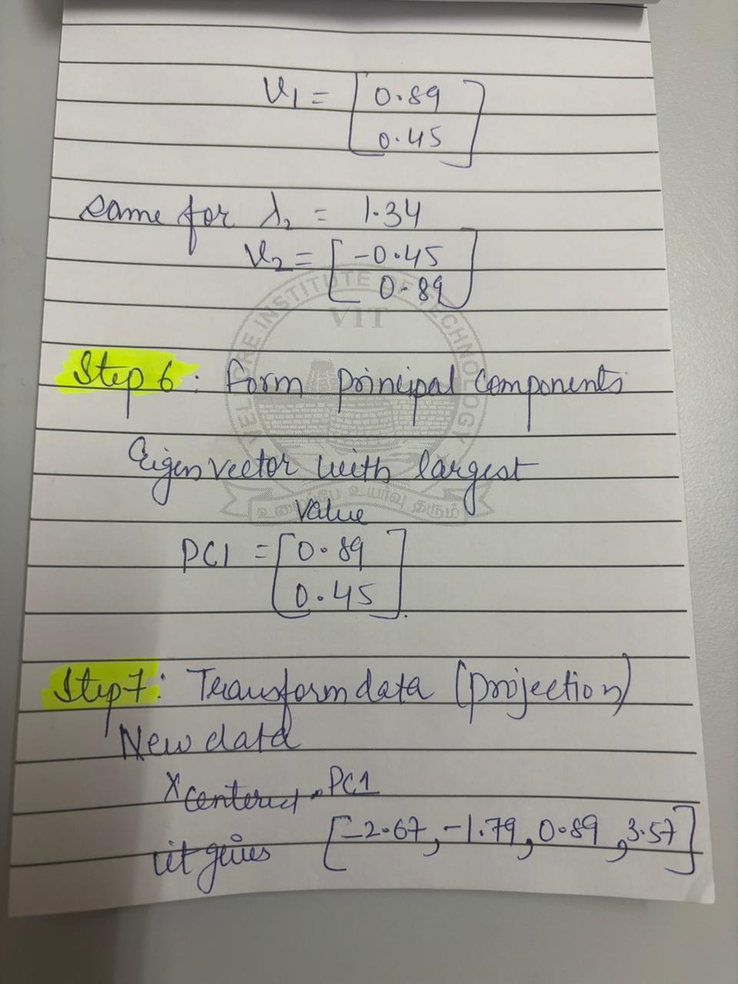
PCA Solved Example

Slide 77
SVD Vs PCA
Singular Value Decomposition (SVD)
What it does: A matrix factorization technique that breaks down any matrix (not just square or symmetric ones) into three simpler matrices (U, Σ, Vᵀ).
Goal: Decompose data into fundamental components (rotations, scaling, another rotation).
How: Gives you singular vectors (directions) and singular values (importance/magnitude).
Principal Component Analysis (PCA)
What it does: Finds new, uncorrelated variables (Principal Components) that capture the maximum variance in the data, helping to reduce dimensions and visualize complex datasets.
Goal: Feature extraction and dimensionality reduction by identifying the most significant patterns (directions of highest variance).
How: Finds eigenvectors and eigenvalues of the covariance matrix.

Slide 78
Statistics: Descriptive Statistics & Statistical Inference
Detailed Explanation with Diagrams

Slide 79
Descriptive Statistics
Descriptive statistics summarizes data.
Measures of Central Tendency: Mean, Median, Mode.
Measures of Dispersion: Variance, Standard Deviation.
Used for understanding dataset characteristics.

Slide 80
Data Distributions
A distribution shows how data values are spread.
Symmetric vs Skewed distributions.
Discrete vs Continuous distributions.

Slide 81
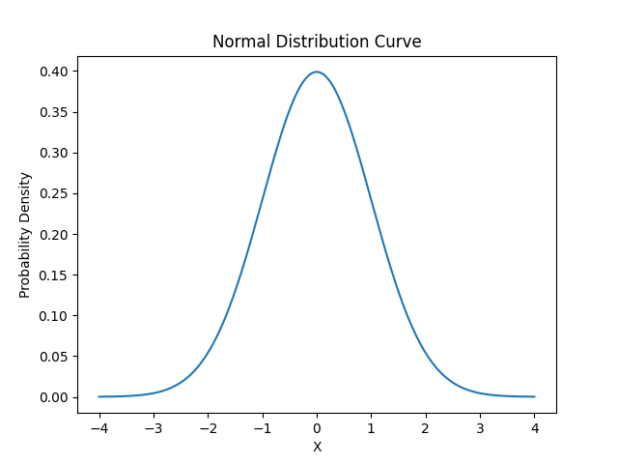
Normal Distribution
Bell-shaped symmetric distribution. Mean = Median = Mode. 68-95-99.7 Rule applies.

Slide 82
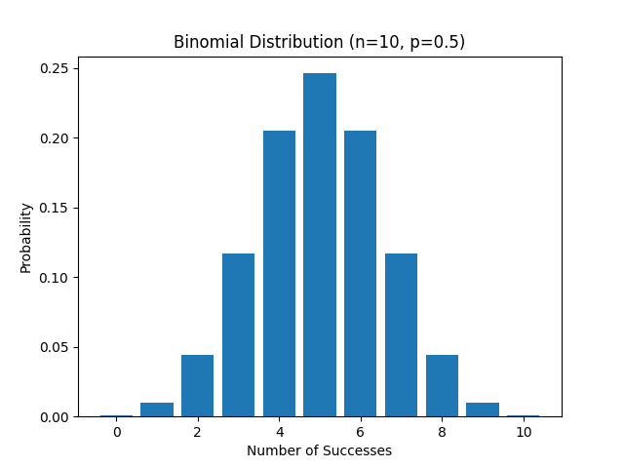
Binomial Distribution
Discrete probability distribution. Fixed number of trials. Two outcomes per trial.

Slide 83
Statistical Inference
Used to draw conclusions about population using sample data.
Includes estimation and hypothesis testing.
Based on probability theory.

Slide 84
Population vs Sample
Population: Entire group of interest.
Sample: Subset selected from population.
Sample statistics estimate population parameters.

Slide 85
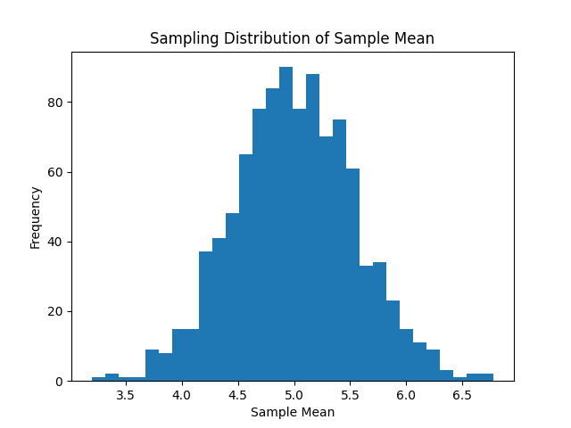
Sampling Distribution (Central Limit Theorem)
Even if population is uniform, sampling distribution of mean approaches normal distribution.

Slide 86
Statistical Modeling
Model represents real-world data mathematically.
Example: Linear Regression, Logistic Regression.
Helps in prediction and inference.

Slide 87
Fitting a Model
Choose appropriate probability distribution.
Estimate parameters (Mean, Variance).
Evaluate goodness of fit (Chi-square, KS test).

Slide 88
Hypothesis Testing
Null Hypothesis (H0) vs Alternative Hypothesis (H1).
Choose significance level α.
Compute test statistic and p-value.
Decision: Reject or Fail to Reject H0.

Slide 89
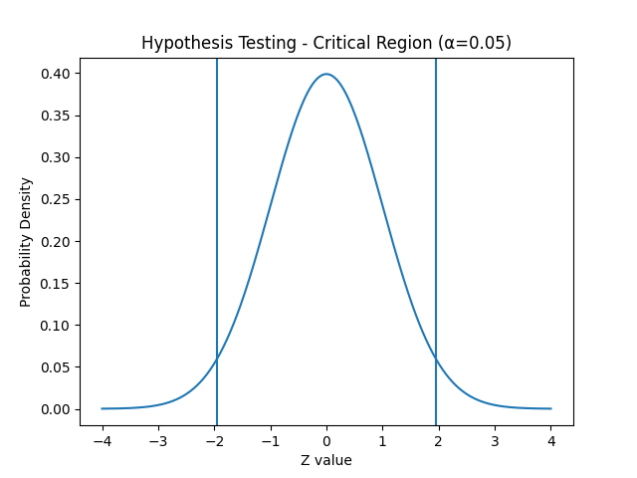
Hypothesis Testing Curve
Critical regions at ±1.96 for α = 0.05 (two-tailed Z-test).

Slide 90
THANK YOU

